Slide 1
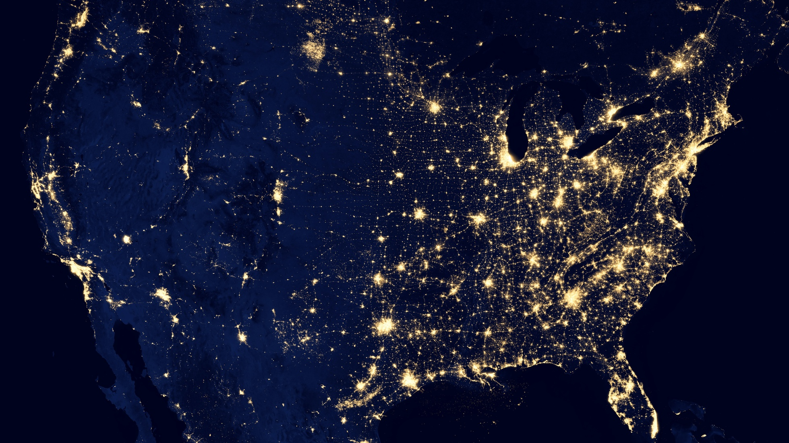

Hand-written Digit Recognition
Using Neural Network
Submitted by | Sumaiya Islam
Submitted to | Kishan Kumar Ganguly
University of Dhaka

Slide 2

Project Overview
Neural network Implementation
Defines functions for initializing the weights and biases of the network
Calculating the softmax vector
Forward propagating through the network to calculate activations
Updating the gradients for a single training example
Running one step of gradient descent to update the network
Calculating the loss

Slide 3
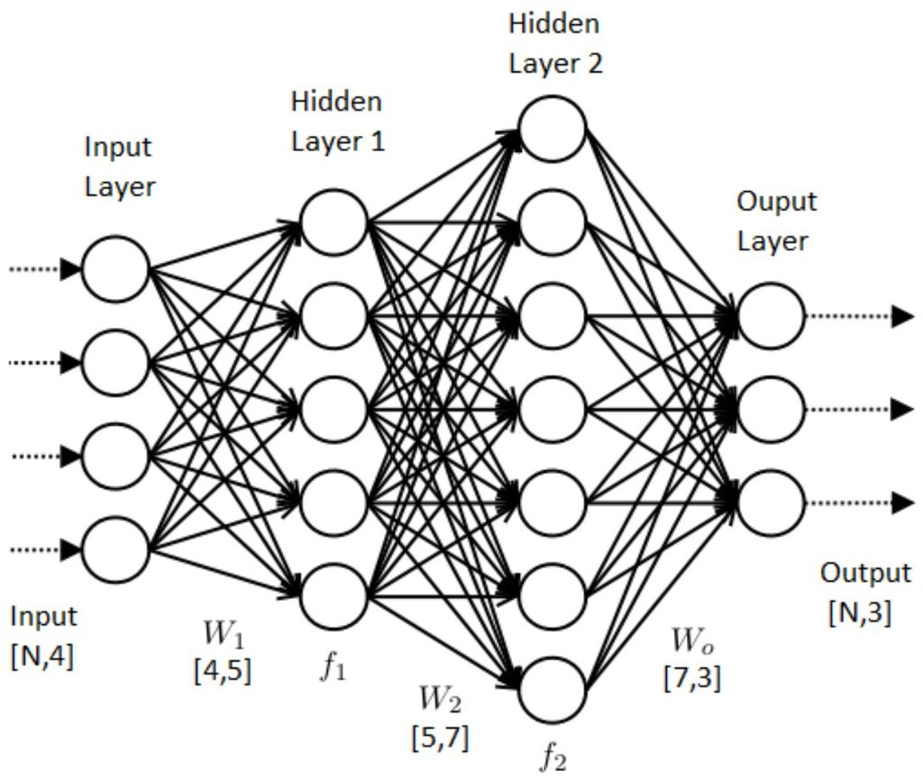
Neural Network Architecture
Training Data - MNIST Dataset
Forward Propagation
Backpropagation
Gradient Update
Training Step
Sample Neural Network for Digit recognition
Code implementation

Slide 4
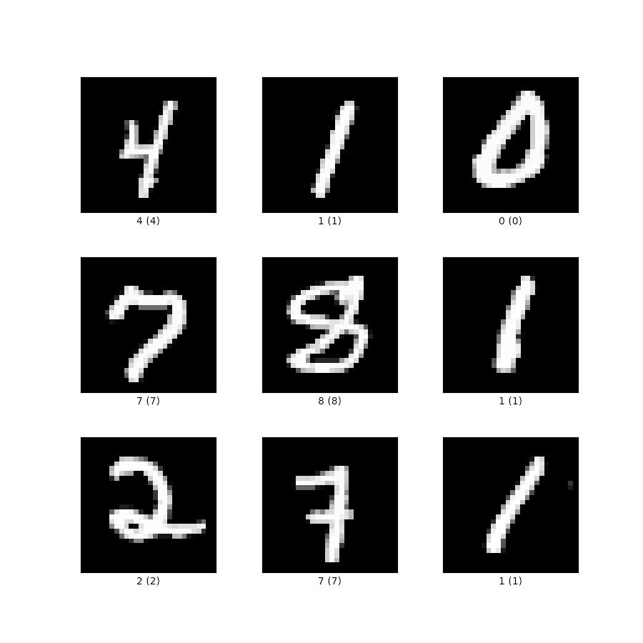
Training Data
MNIST Dataset
Collection of handwritten digits (0-9)
28x28 pixels
60,000 training images and labels
10,000 test images and labels

Slide 5

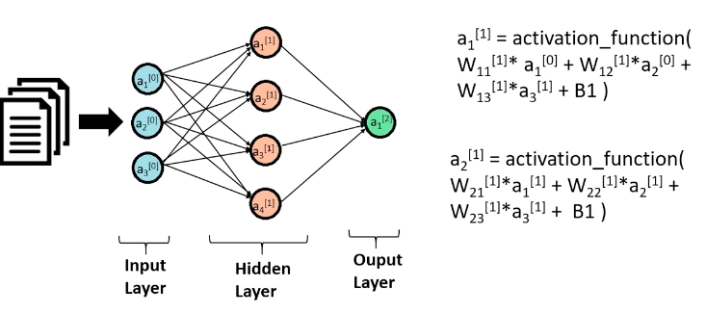
Forward Propagation.

Slide 6
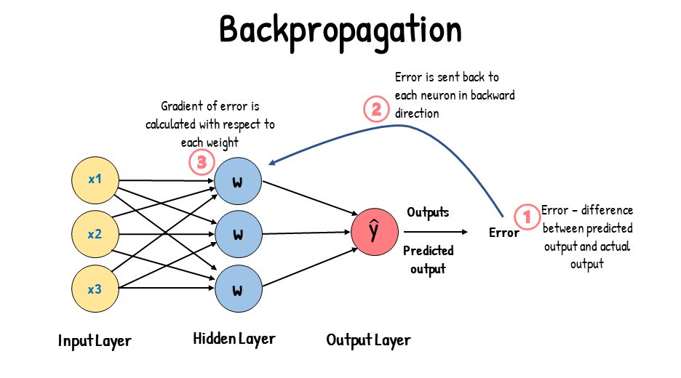

Slide 7
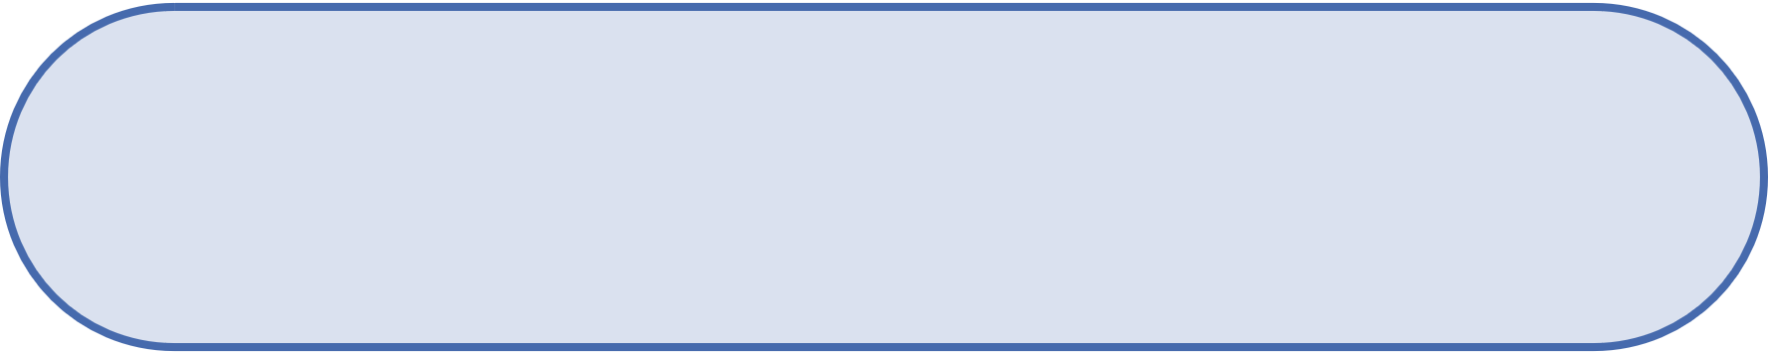
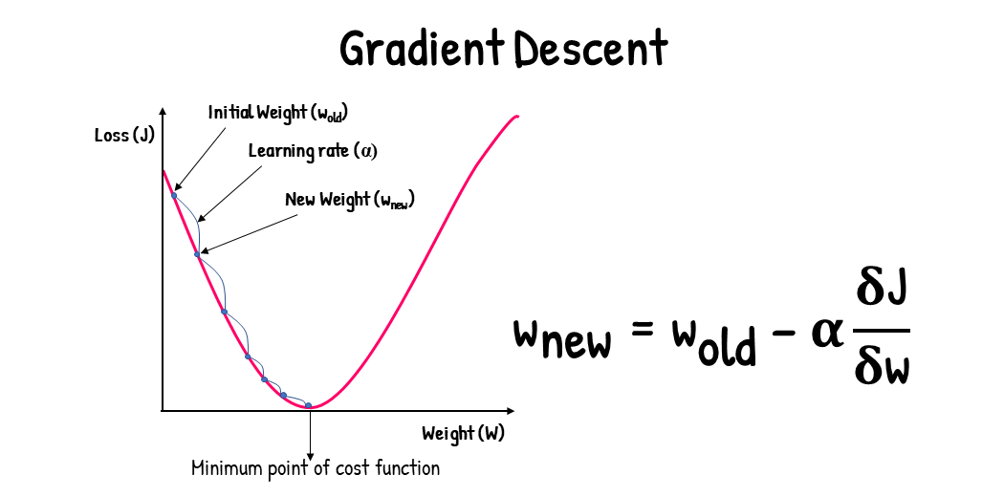
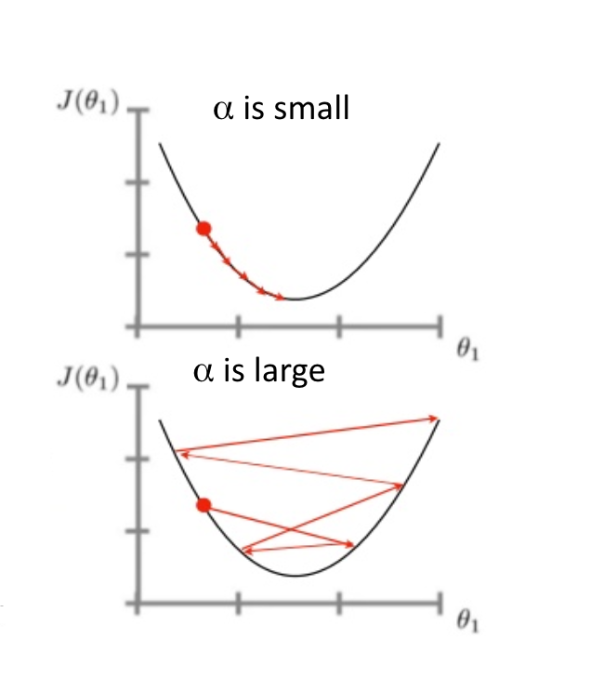
Gradient Descent

Slide 8
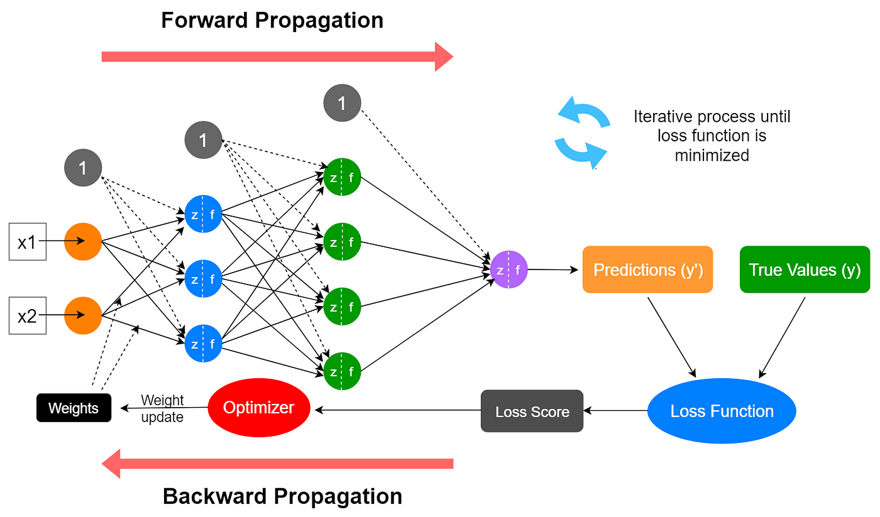

Slide 9
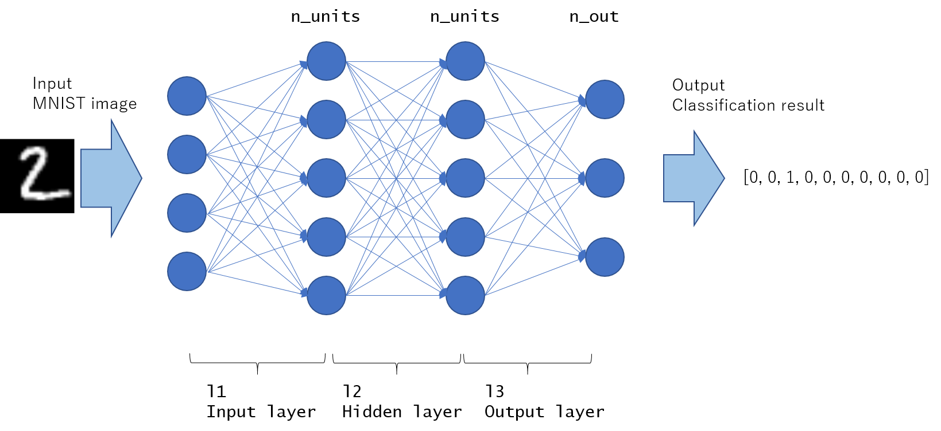
Sample Neural Network for Digit recognition

Slide 10
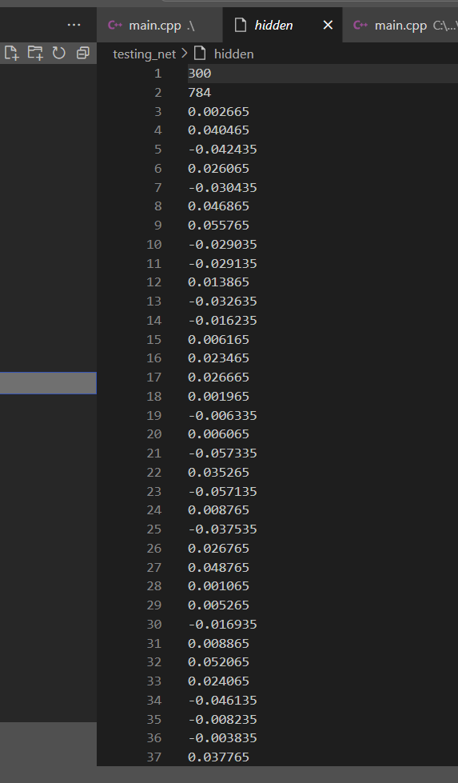
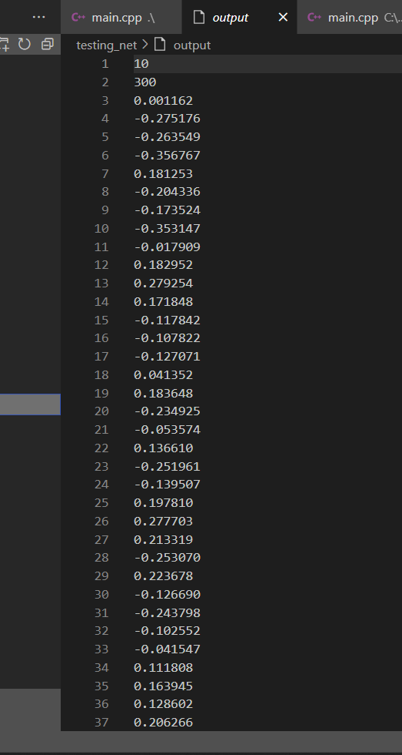
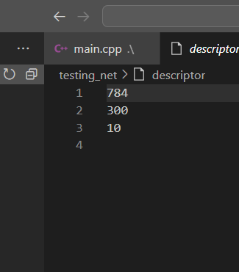
Descriptor
Output
Hidden

Slide 11
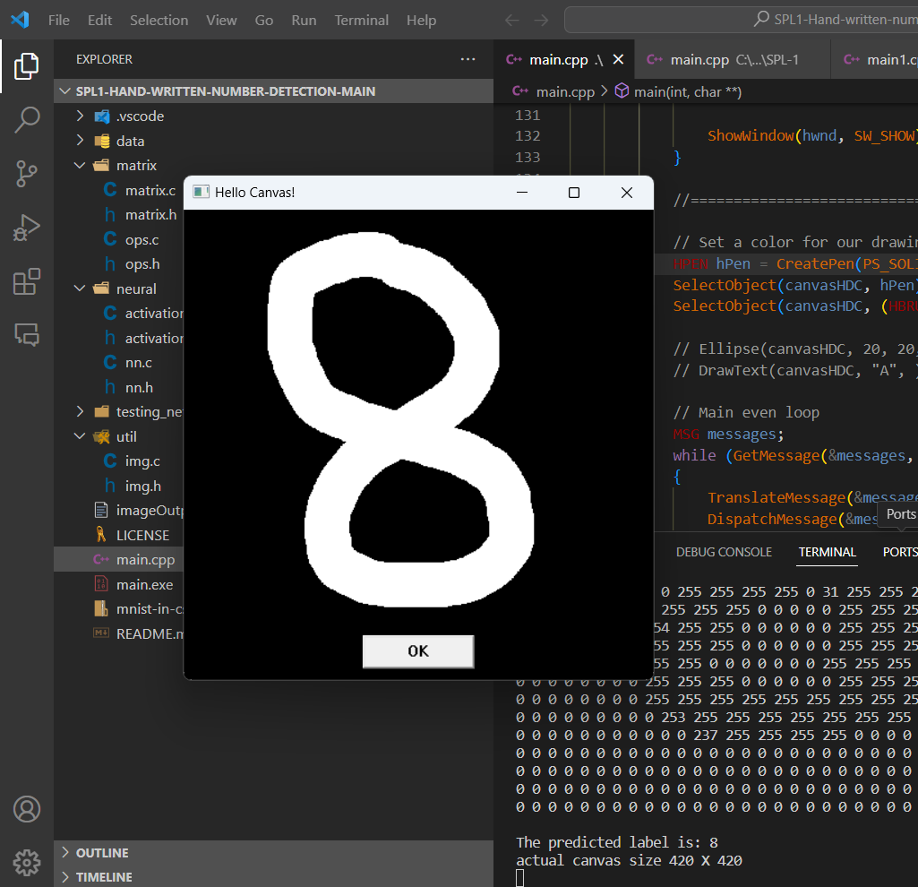
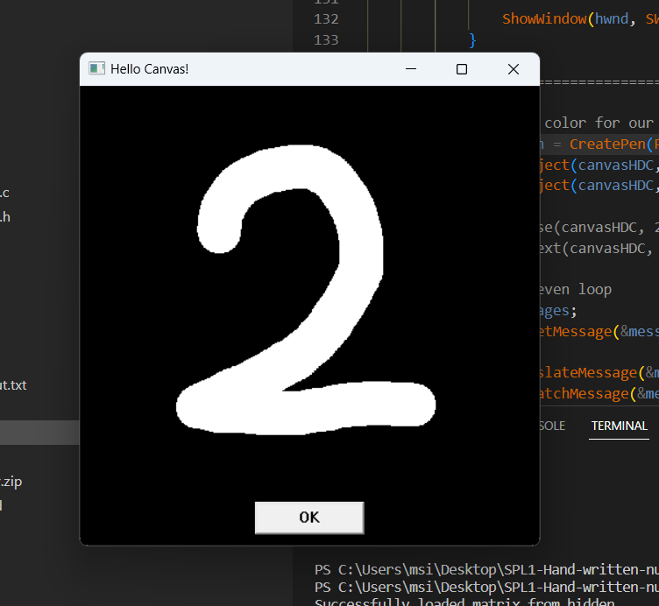
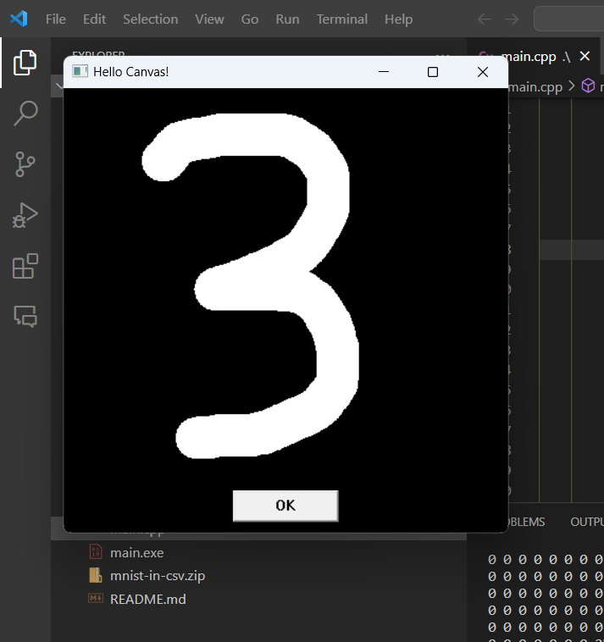
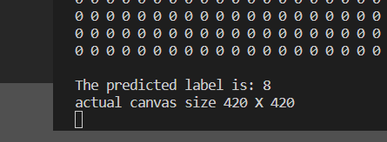
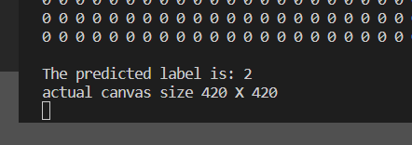
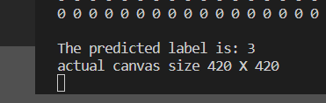

Slide 12



Milestone 1
Milestone 3
Increase the efficiency
Add more hidden layers to the network
Midterm
Final
Milestone 2
Optimize the performance
NEXT STEPS

Slide 13

Repository Link
Software Project Lab

Slide 14

Thank you.

